Slide 1
IoT and Spark Streaming
B A Saran(22011102012) Jabin Joshua S(22011102027) Madhavv Arul(22011102053) Muhammad Farhaan(22011102059)

Slide 2

What is Apache Spark?
Open-source distributed computing framework.
Designed for fast and large-scale data processing.
Supports batch, real-time (streaming), machine learning, and graph processing.
What is Spark Streaming?
An extension of Spark for real-time stream processing.
Processes data from sources like Kafka, Flume, and MQTT in micro-batches.
Enables real-time analytics on IoT, financial transactions, social media feeds, etc.

Slide 3
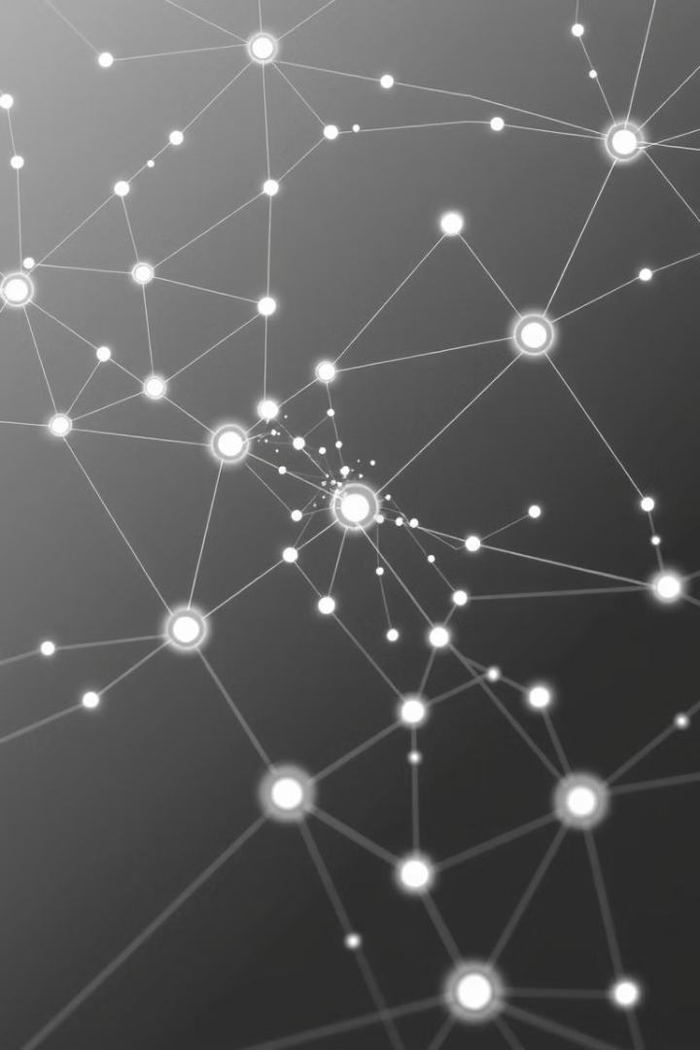
Core Concepts
1
Discretized Streams (DStreams)
2
Micro-Batching
Incoming data divided into small batches for processing. Spark processes each batch, providing near real-time analytics.
Continuous data stream represented as a sequence of RDDs. Each RDD holds data from a micro-batch interval.
3
Data Sources & Sinks
Sources include Kafka, Flume, and MQTT. Sinks are HDFS, NoSQL, Kafka, and dashboards.

Slide 4
Architecture and Fault Tolerance
Workflow
RDD Lineage
WAL (Write-Ahead Logging)
Checkpointing
Data streams from sources into Spark. Spark processes and transforms data. Processed data is stored or visualized.
Lost data recomputed if a worker node fails. Provides data recovery and reliability.
Stores metadata to recover from failures. Enables stateful stream processing.
Ensures data persistence before processing. Prevents data loss during failures.

Slide 5
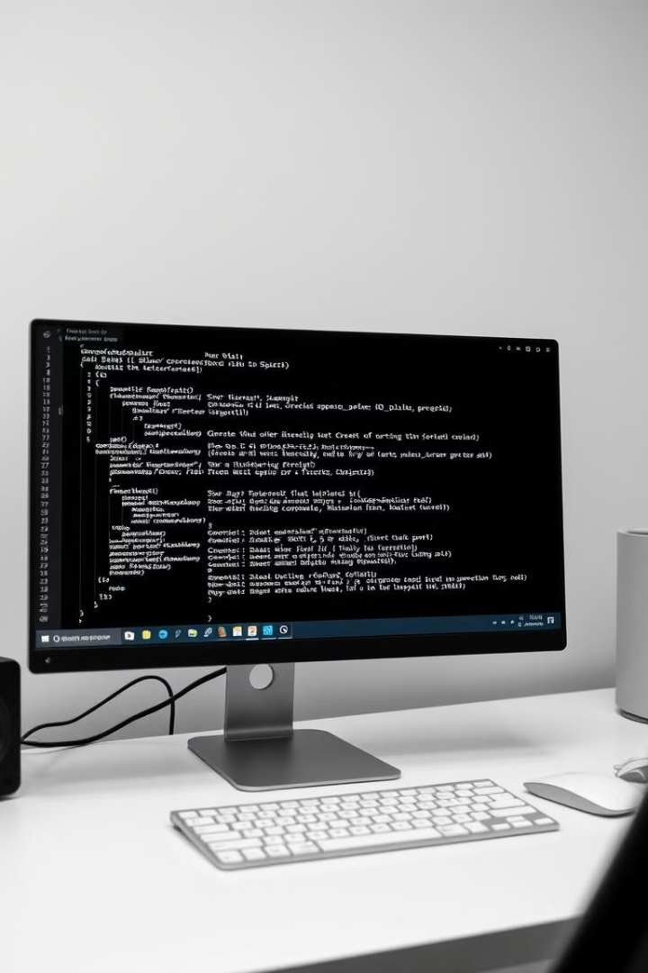
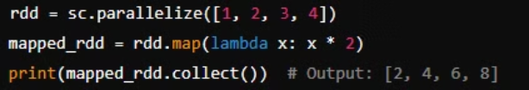
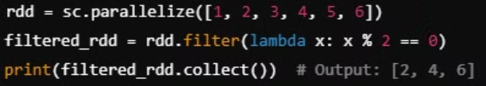


Key Transformations
map(): Applies a function to each RDD element
filter(): Removes unwanted data based on a condition
reduceByKey(): Aggregates values by key for grouped processing
countByValue(): count the occurrences of each unique value

Slide 6
Spark Streaming vs. Structured Streaming
Feature
Spark Streaming
Structured Streaming
Processing Model
Micro-batching (RDDs)
Continuous (DataFrames)
API Complexity
Low-level DStreams API
Higher-level SQL/DataFrame API
Fault Tolerance
RDD checkpointing
Built-in with WAL
Late Data Handling
Limited
Better event-time handling
Performance
Decent
Optimized with Catalyst and Tungsten

Slide 7
IoT Data Challenges and Spark’s Relevance
High Data Velocity
Real-time Processing
Continuous real-time data flow from sensors and devices requires immediate processing.
Spark Streaming handles continuous IoT data streams efficiently.
Huge Data Volume
Scalability
The massive influx of data from millions of connected IoT devices is a core issue.
Spark's distributed architecture allows for large-scale IoT data handling.
Data Variety
Fault Tolerance
IoT devices generate diverse structured, semi-structured, and unstructured data types.
RDDs ensure reliability and prevent data loss during failures.

Slide 8
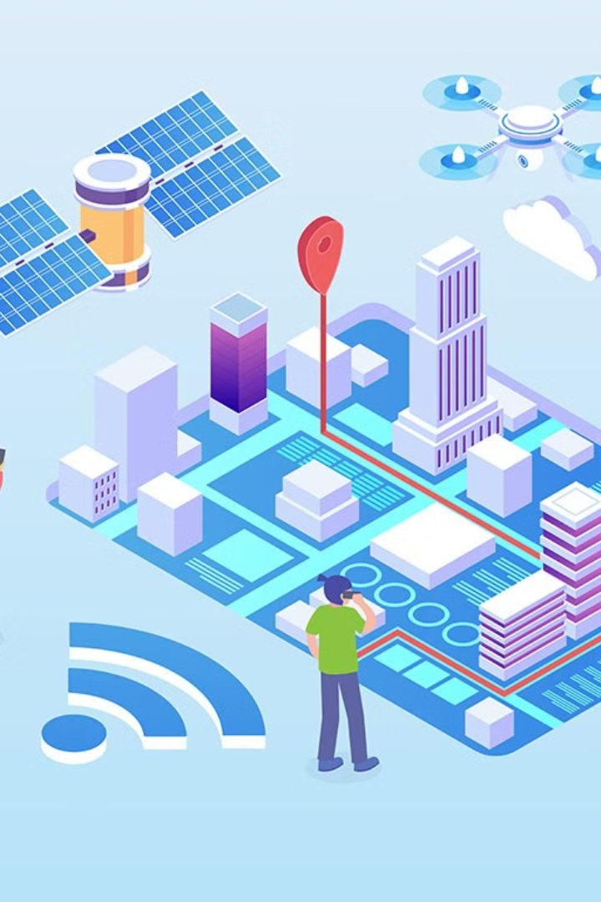






IoT Use Cases
Predictive Maintenance
Anomaly Detection
Smart Manufacturing
Analyze sensor data to predict equipment failure.
Identify unusual patterns for security or fraud.
Optimize production processes in real-time.
Connected Vehicles
Smart Agriculture
Healthcare Monitoring
Real-time monitoring and analytics for vehicles.
Monitor soil moisture and weather conditions for precision farming
Analyze patient vitals from wearable devices for early alerts.

Slide 9





IoT System Architecture
Data Ingestion
Edge Devices
2
MQTT broker receives data.
1
Sensors collect data.
Spark Streaming
3
Processes data in real-time.
5
Visualization
Dashboards display insights.
4
Storage
Data stored in database.

Slide 10
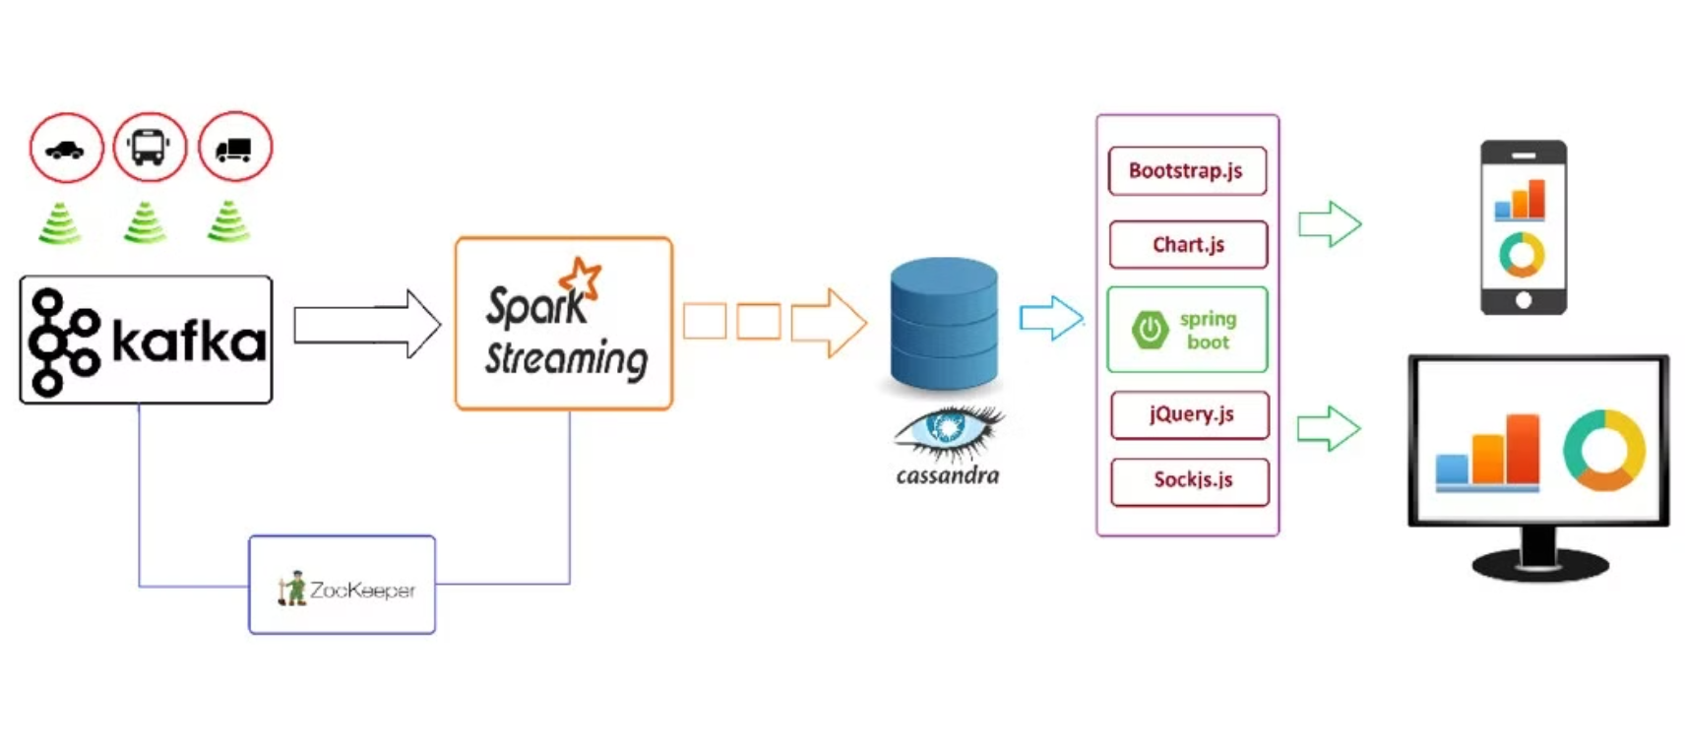

Slide 11
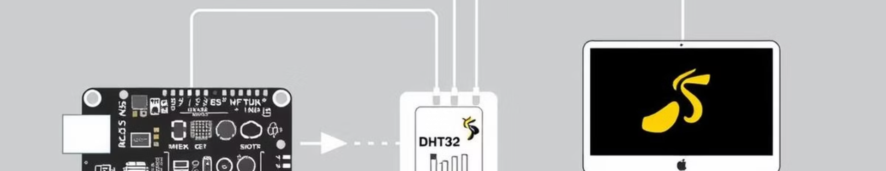
Collecting Temp Data
Visualize
Spark
Results visualized on dashboards, can also be combined with ML
MQTT
Spark Streaming consumes MQTT data.
Hardware
ESP32 sends data to MQTT broker.
ESP32 microcontroller and DHT11 sensor.

Slide 12
Predicting Temp
Data Collection
Gather temperature data from DHT11 sensors using ESP32 microcontrollers.
Spark Streaming Pipeline
Set up a Spark Streaming job to consume temperature data from the MQTT broker.
ML Model Training
Train a regression model/LSTM to predict temperature based on historical data.
Real-Time Prediction
Apply the trained model to real-time data for predictive analytics and visualization.

